Slide 1
TOURISM MANAGEMENT SYSTEM
PRESENTED BY –
ABHISEK DAS
AMBUJ TIWARI
ANAMITRA DAS
ARKAJYOTI SAHA
ANANYA SAMANTA

Slide 2
INTRODUCTION
Our Tourism Management System allows the user of the system to access all the details such as location details, events, tour details, etc. The main purpose is to help tourism companies to manage customers, hotels, etc. safely by both site admins and tour managers. It can be used for both business and professional trips.

Slide 3
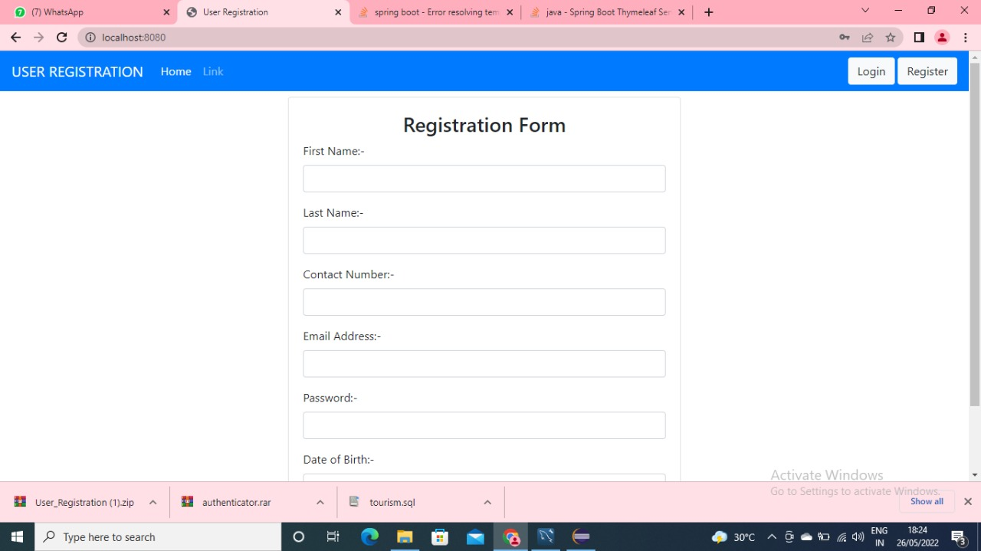
USER REGISTRATION

Slide 4
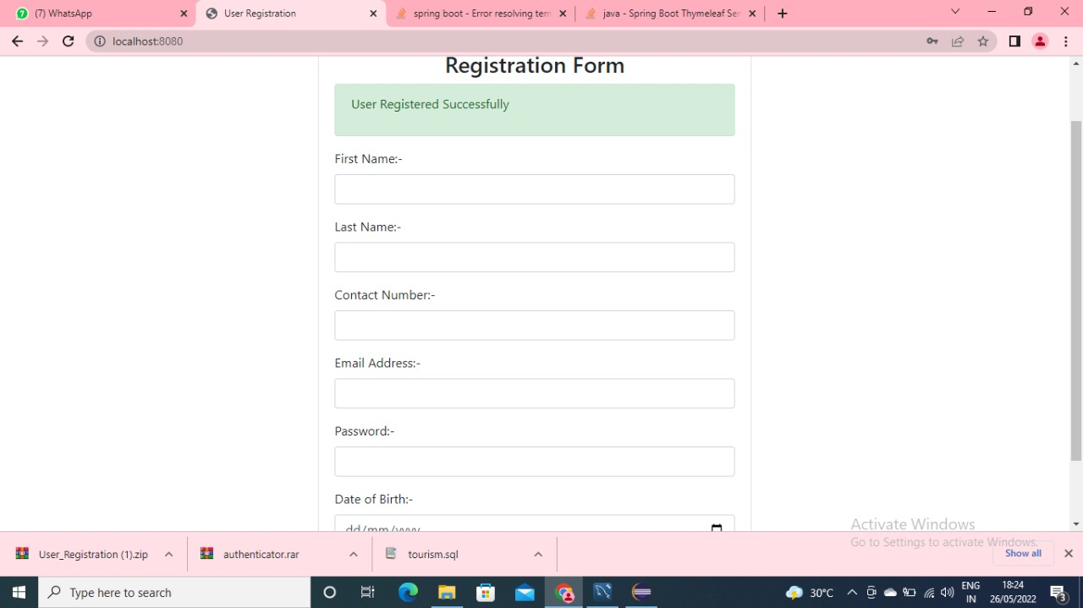
USER REGISTRATION PAGE WHEN REGISTRATION SUCCESSFUL

Slide 5
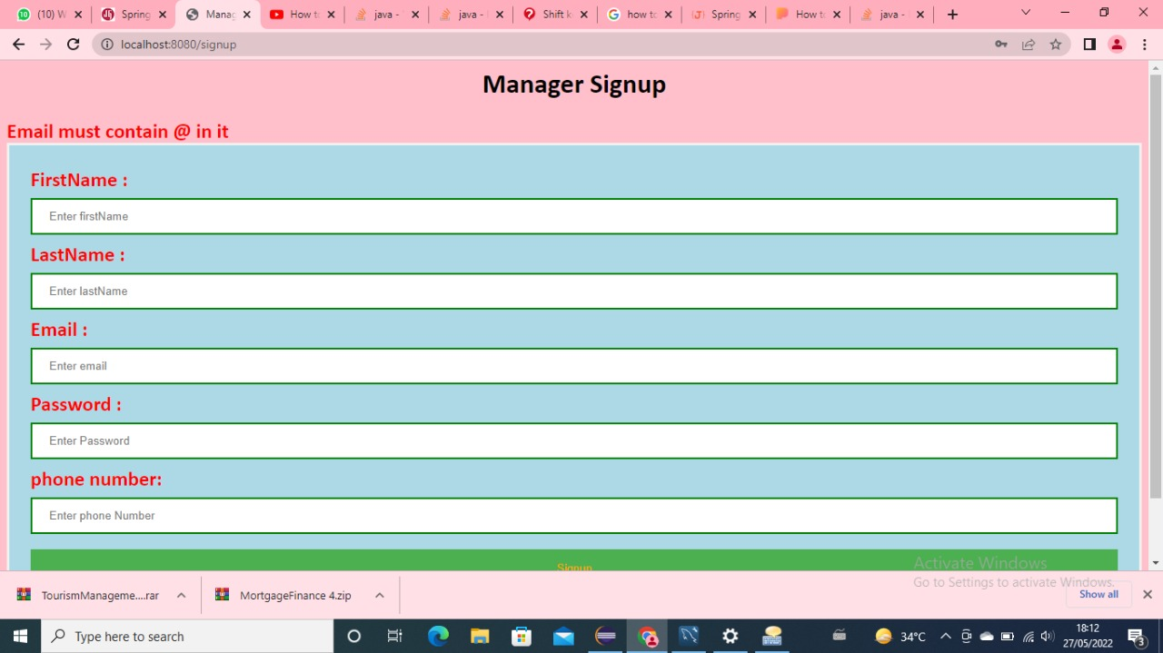
USER REGISTRATION ACCESS ERROR

Slide 6
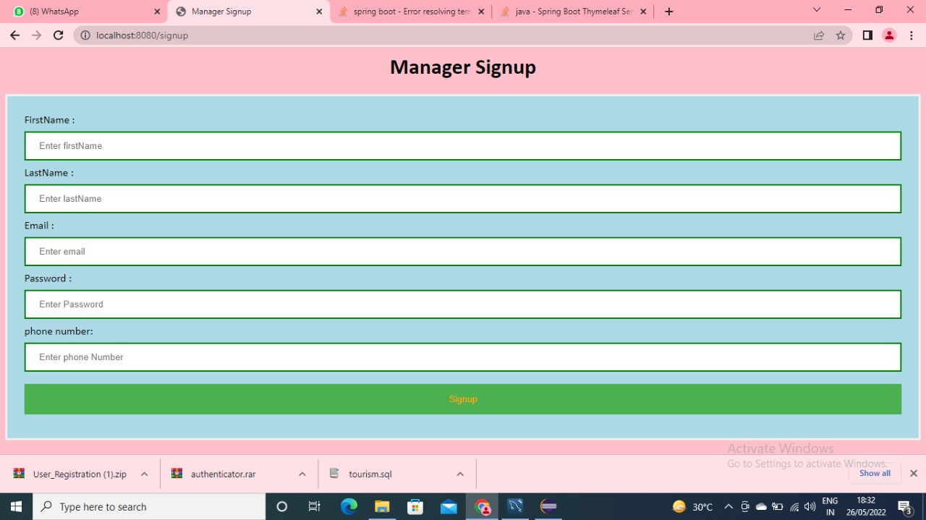
MANAGER SIGNUP PAGE

Slide 7
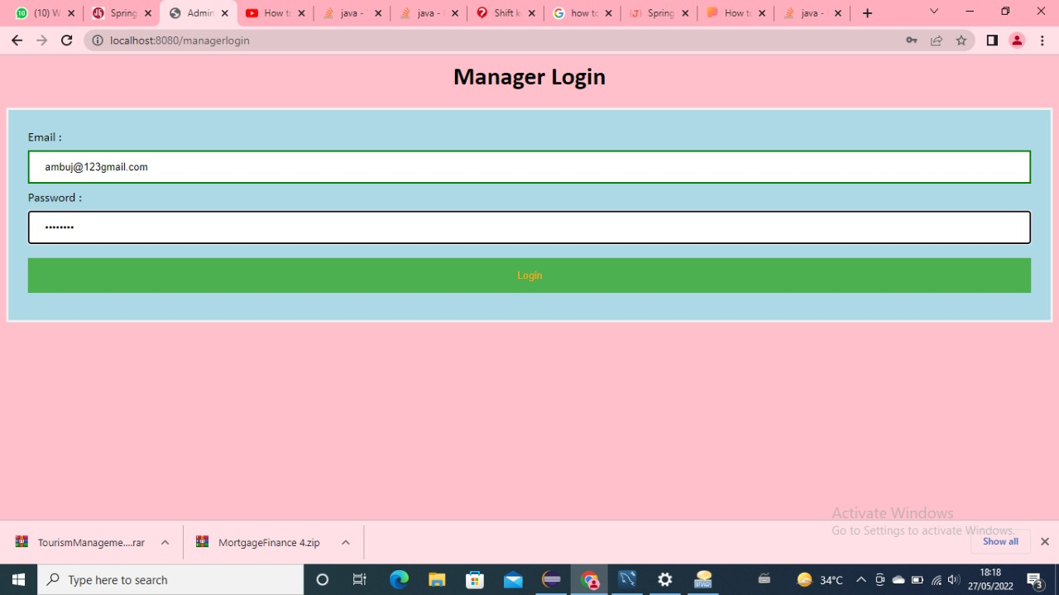
MANAGER LOGIN

Slide 8
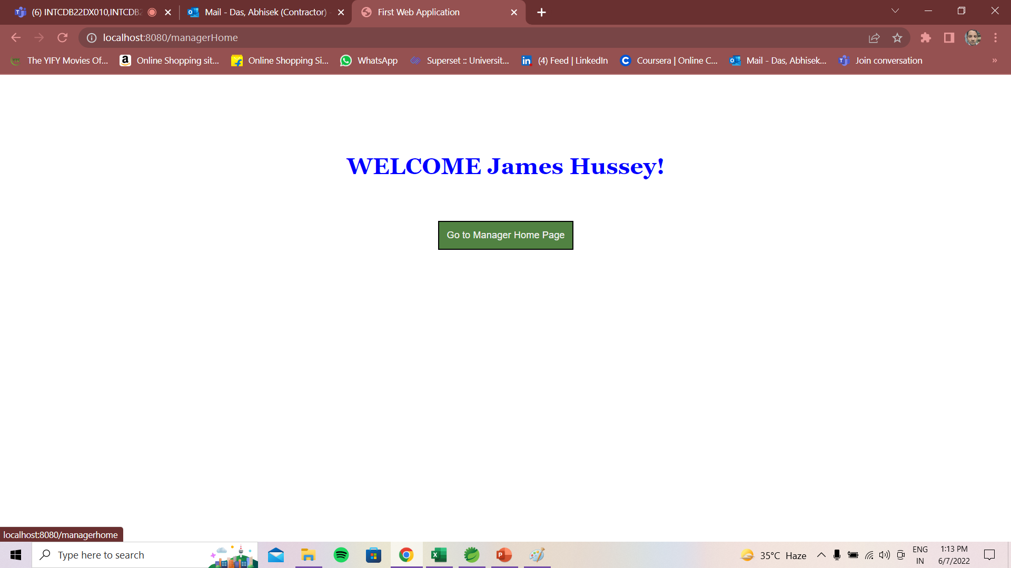
SUCCESSFUL MANAGER LOGIN

Slide 9
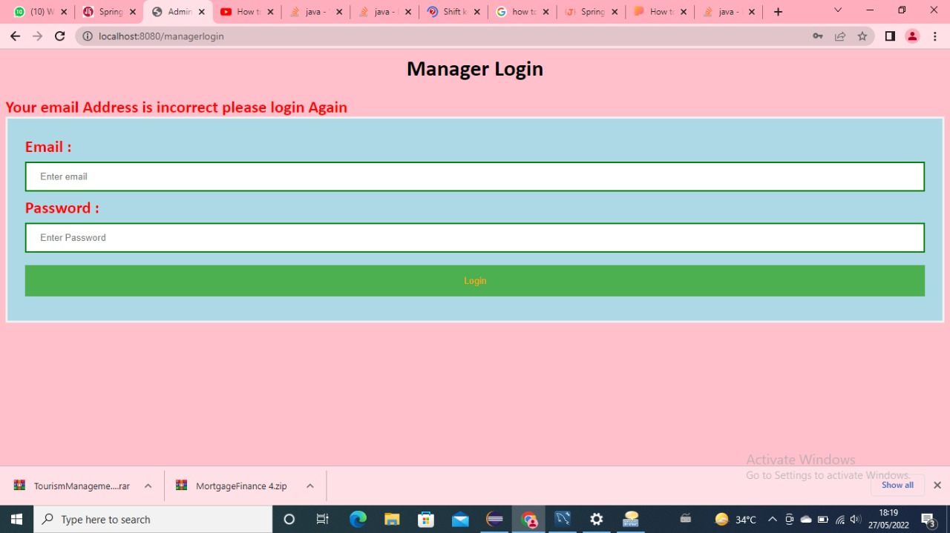
MANAGER LOGIN ACCESS ERROR

Slide 10
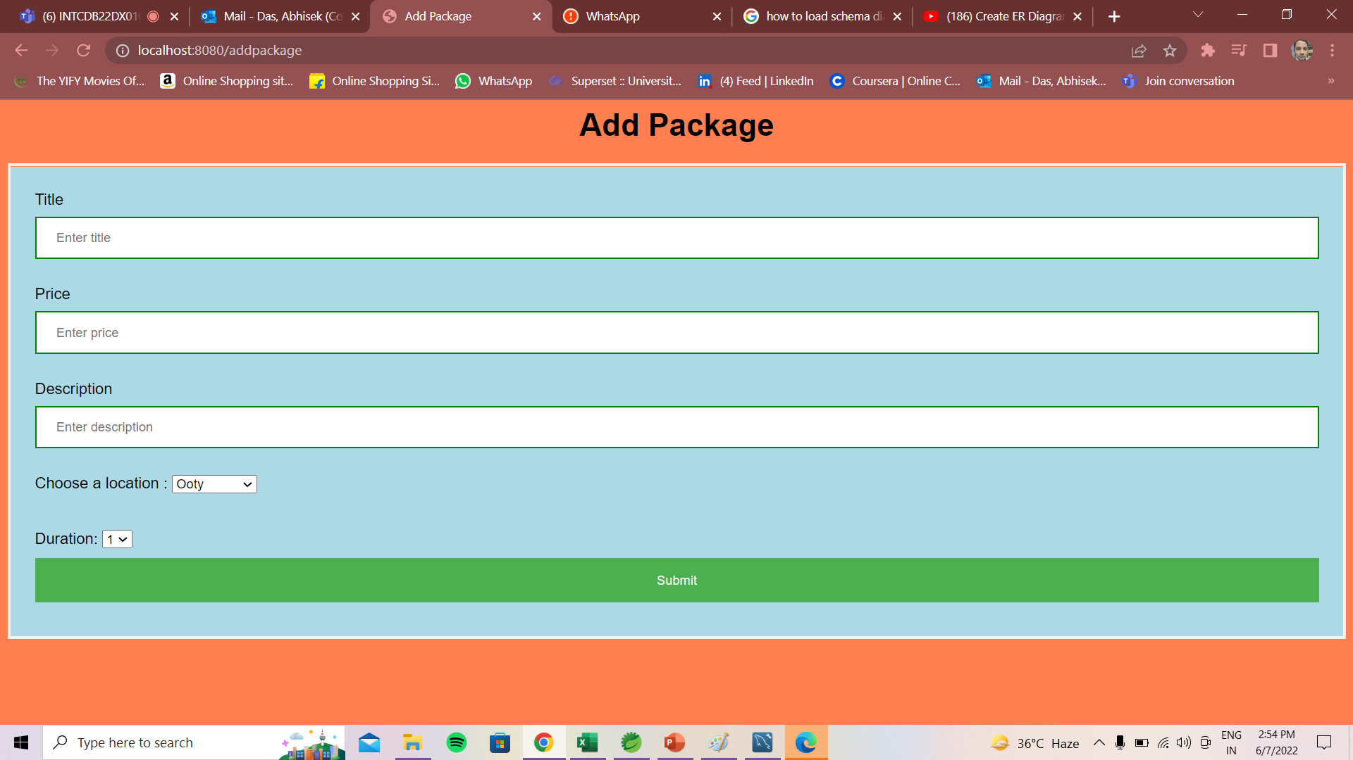
CREATE AND MANAGE PACKAGE

Slide 11
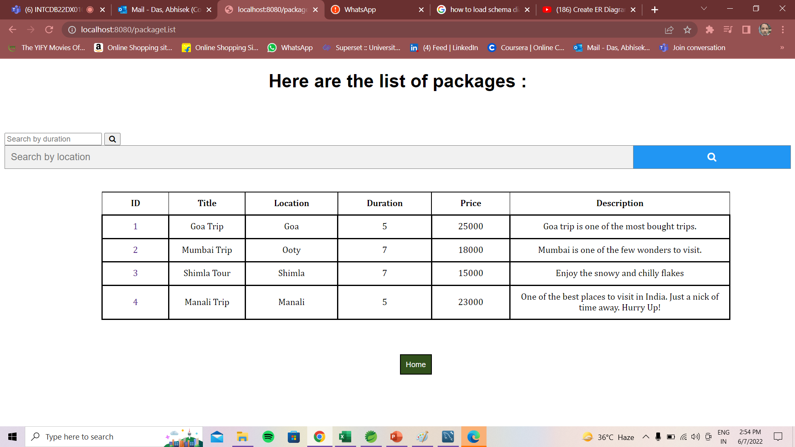
PACKAGE LISTINGS

Slide 12
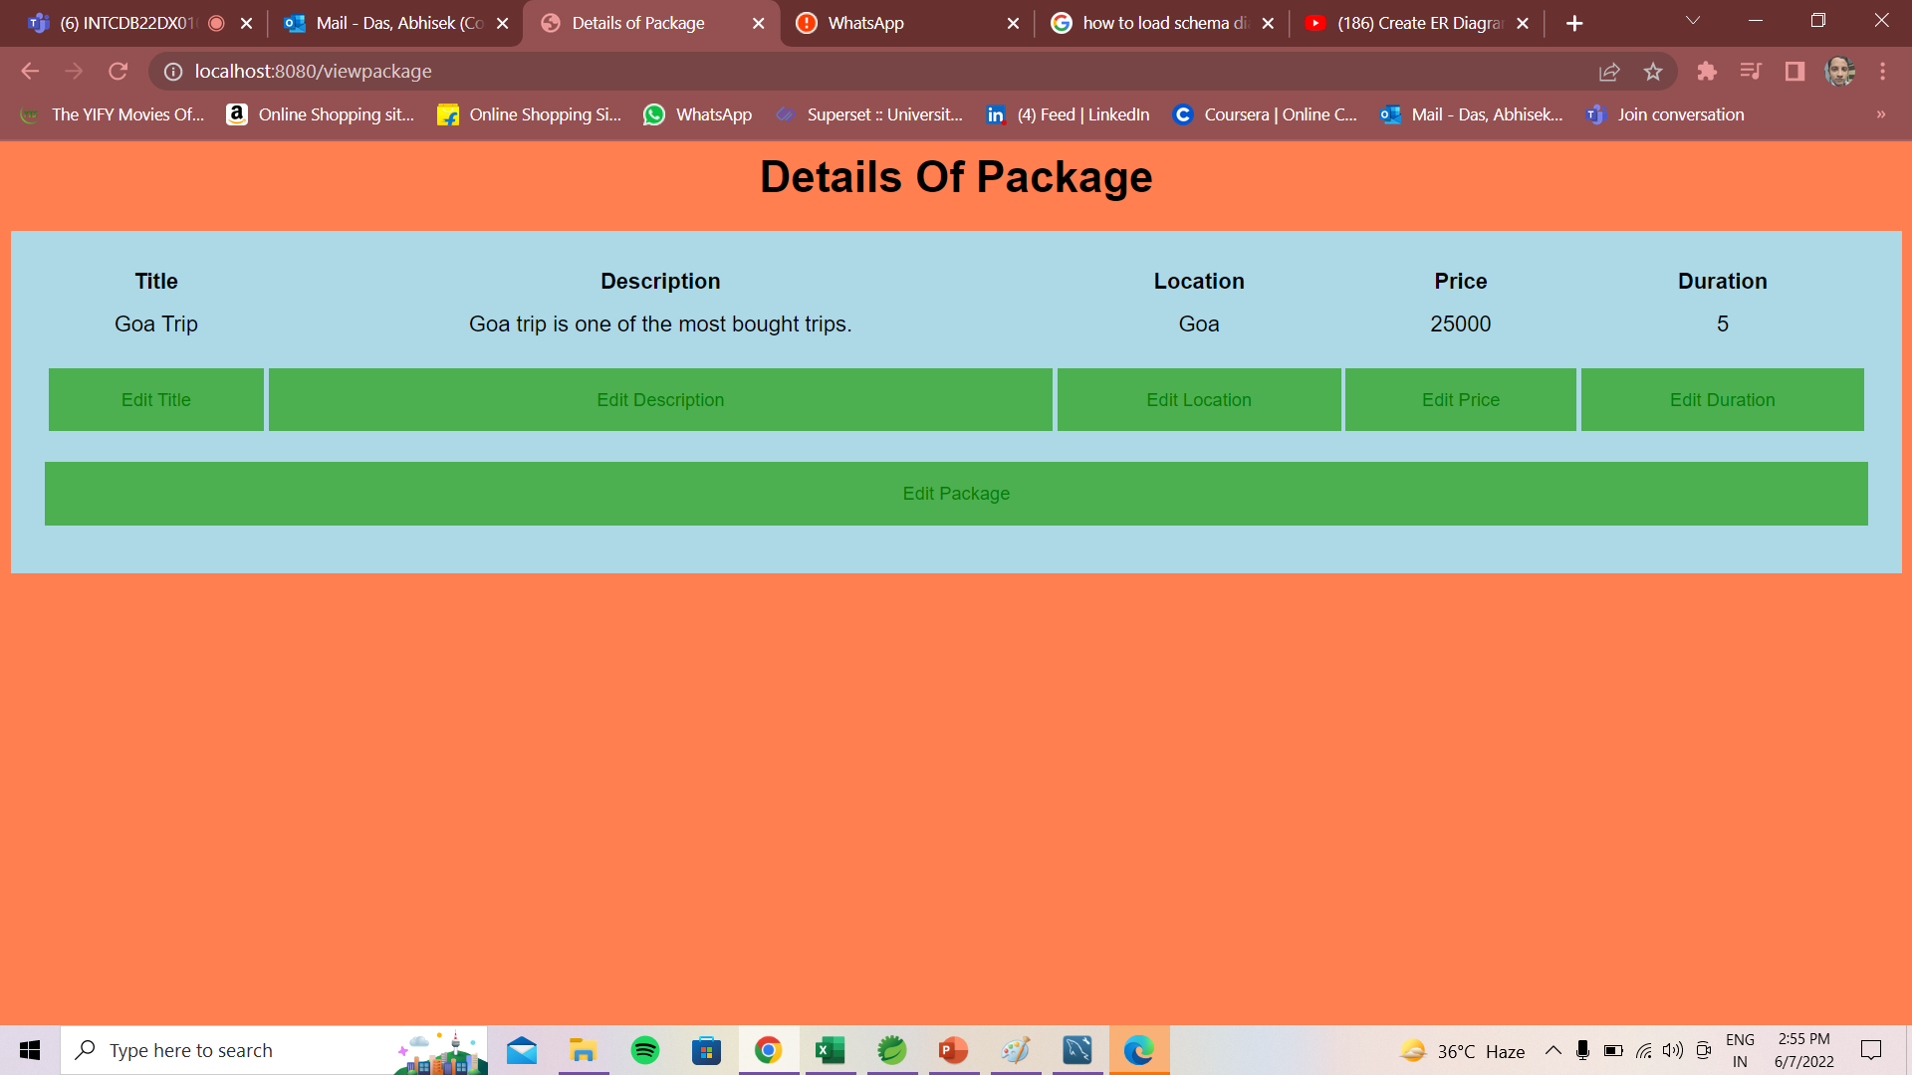
ADD AND MANAGE PACKAGES

Slide 13
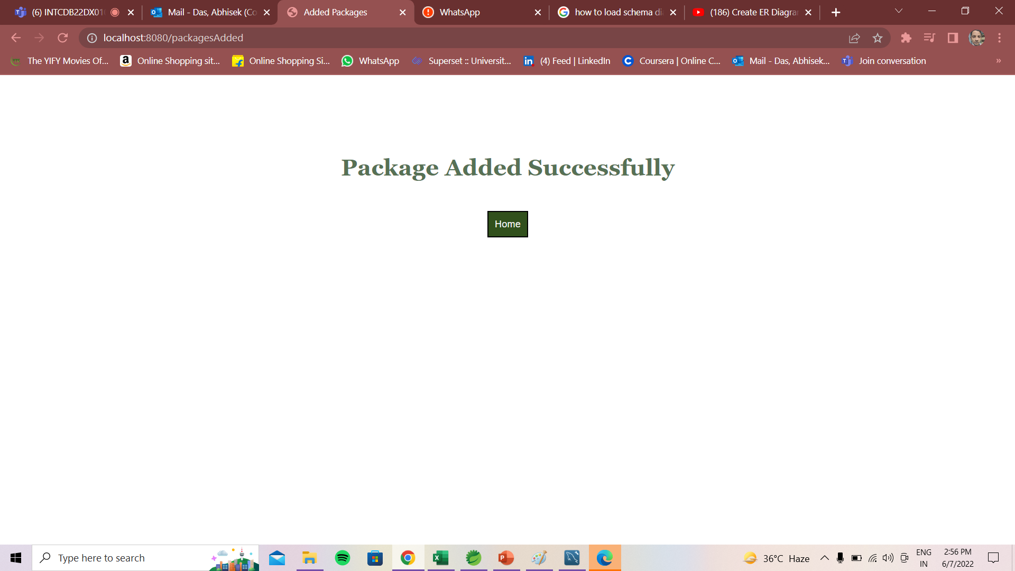
SUCCESSFUL CREATION OF PACKAGE

Slide 14
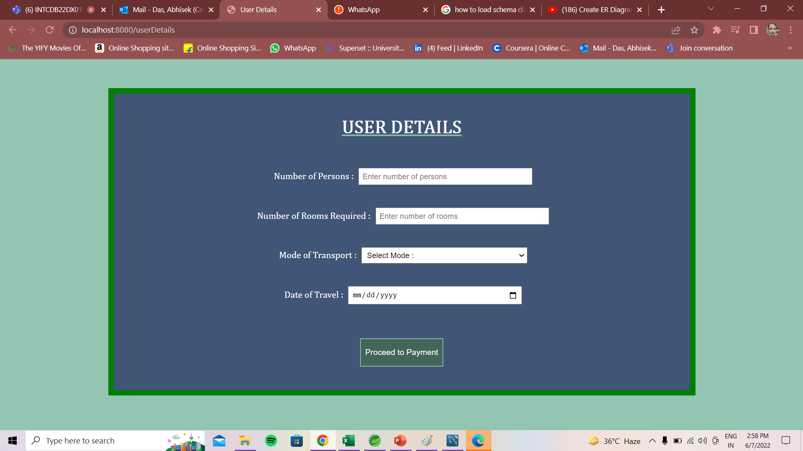
PAYMENT FORM

Slide 15
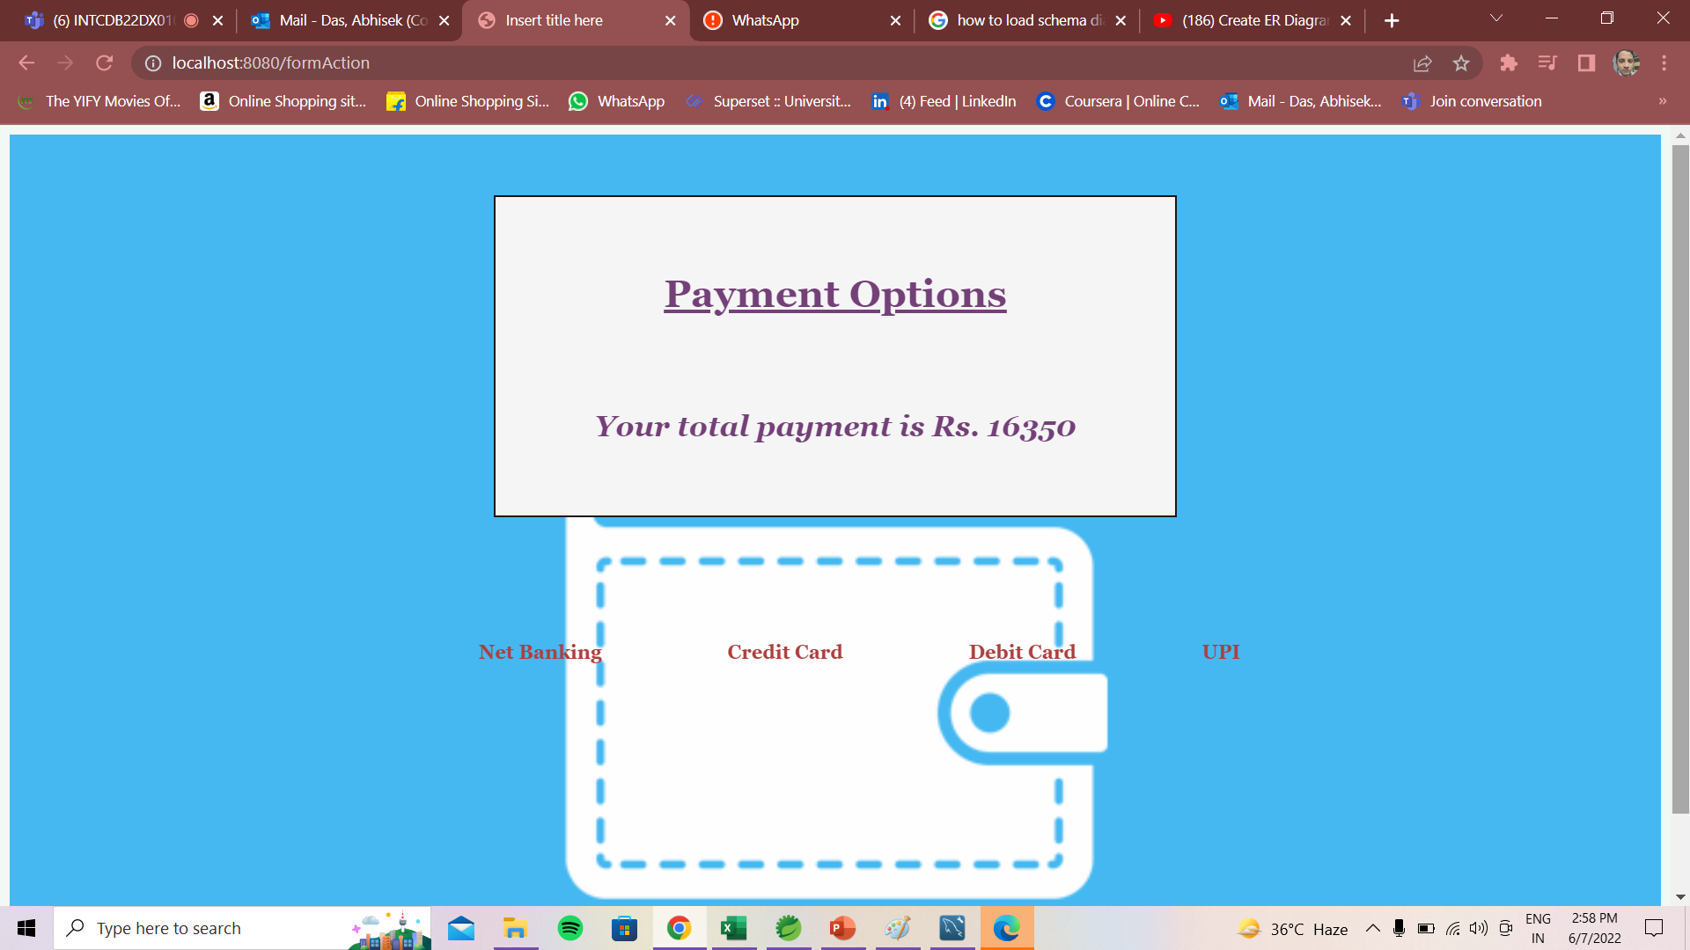
PAYMENT PAGE (MOCKED PAYMENY)

Slide 16
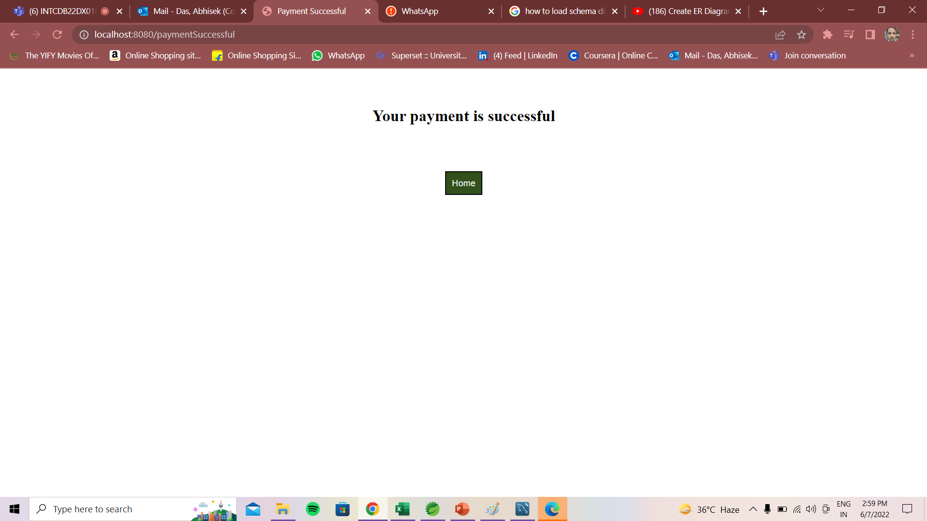
PAYMENT SUCCESSFUL - RECEIPT

Slide 17


